Slide 1

REVOLUTION ART
CS691 – Project 1
Team 1

Slide 2
Meet the Team
Project Manager: Zo DiSanto
Project Owner: Melika Zandikarimi
Business Analyst: Jianan Jiang
Lead Developer: Shanshan Li
Developer: Kishore Kanchan
Lead DBA: Rufan Mirganiyev
QA Analyst & Tester: Louise Ngo

Slide 3
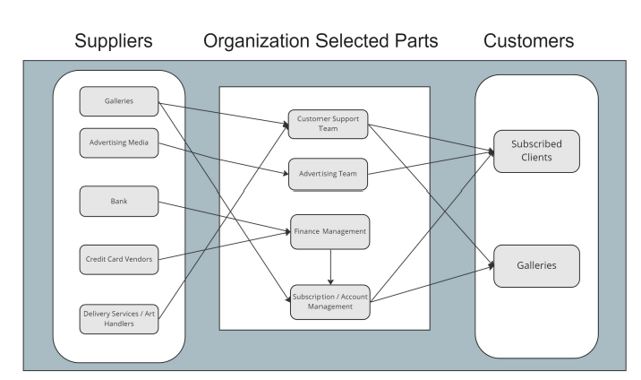
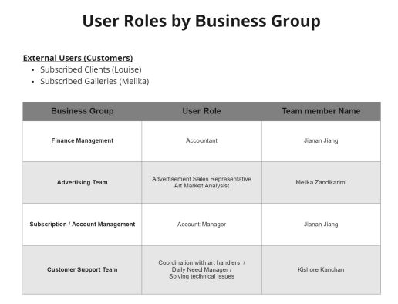
BRM

Slide 4
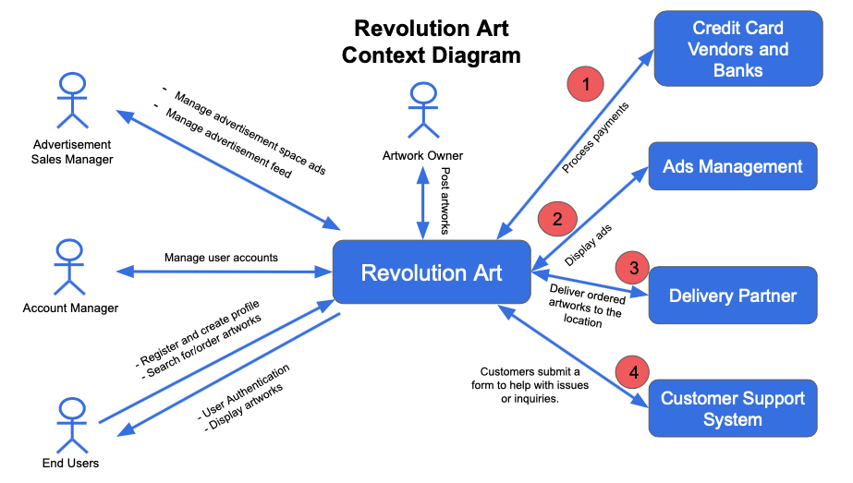
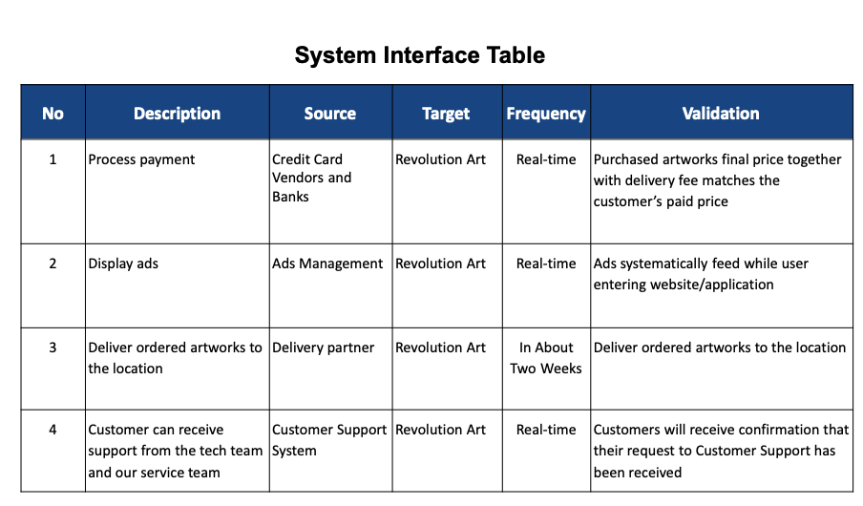
Context Diagram

Slide 5
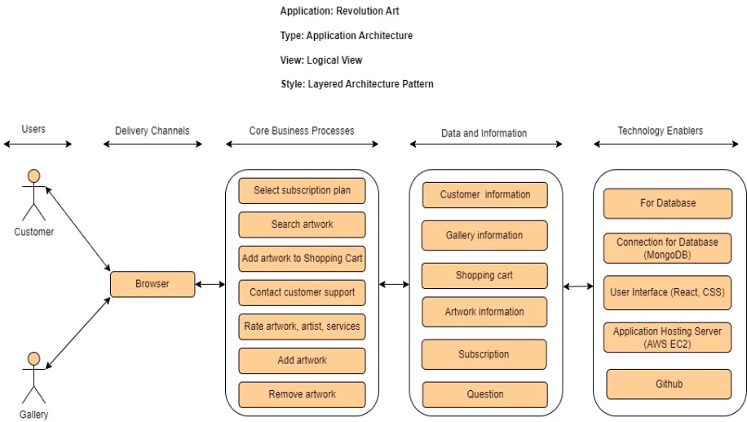
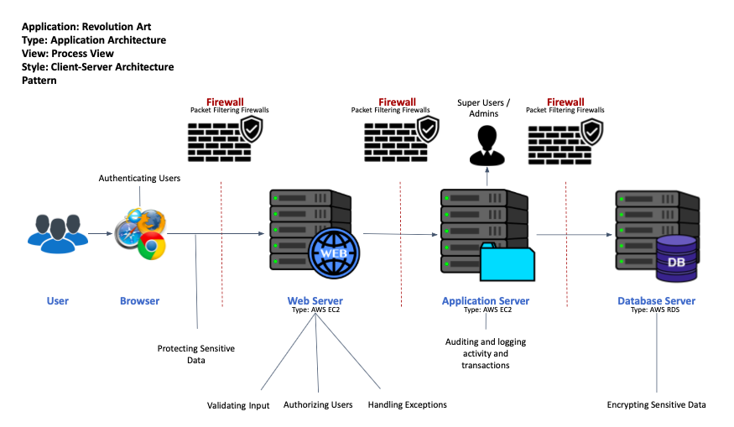
Architecture Diagram

Slide 6
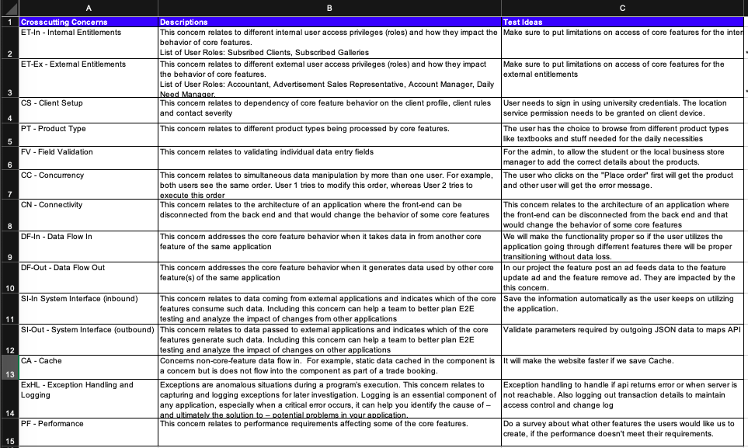
RCT

Slide 7
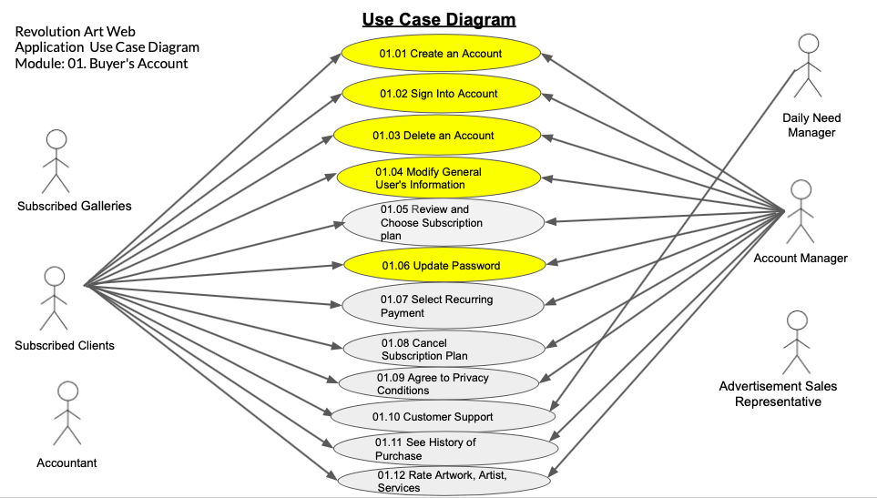
Use Case Diagram

Slide 8
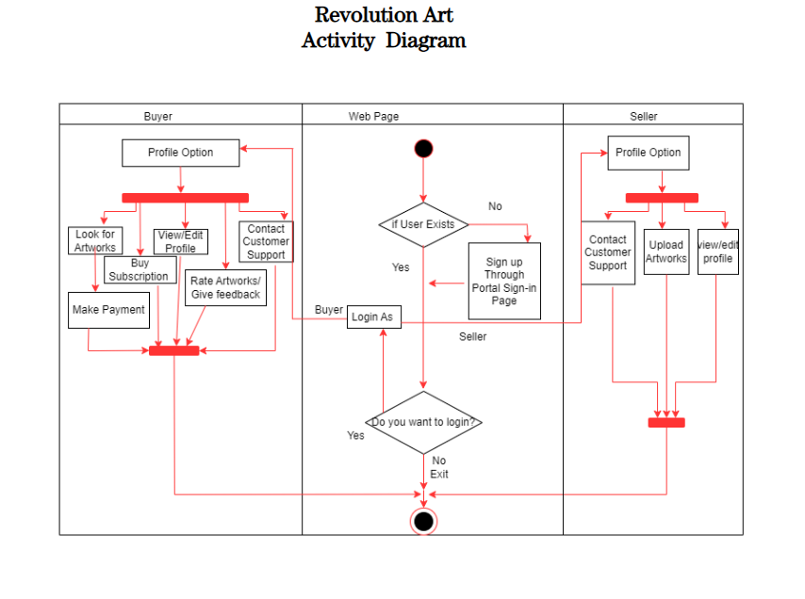
Activity Diagram

Slide 9
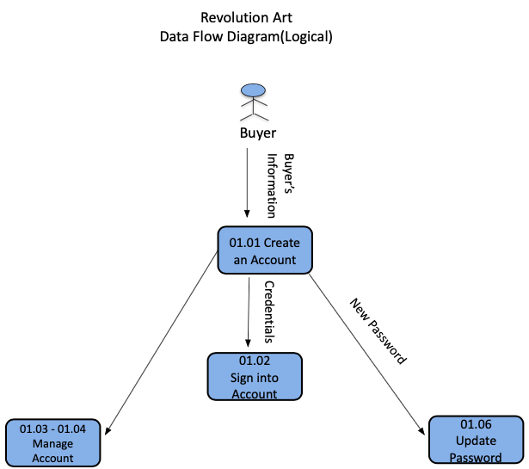
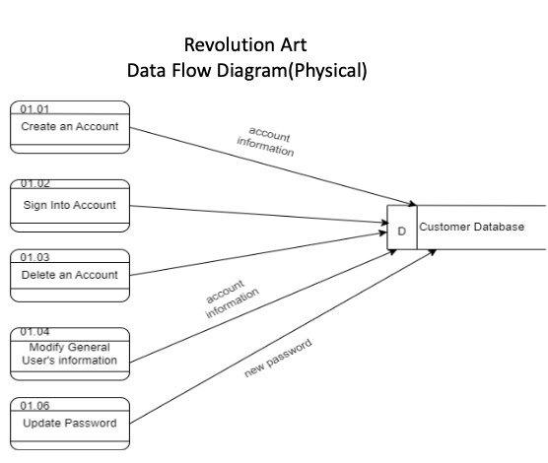
Data Feed Diagram (Logical & Physical)

Slide 10
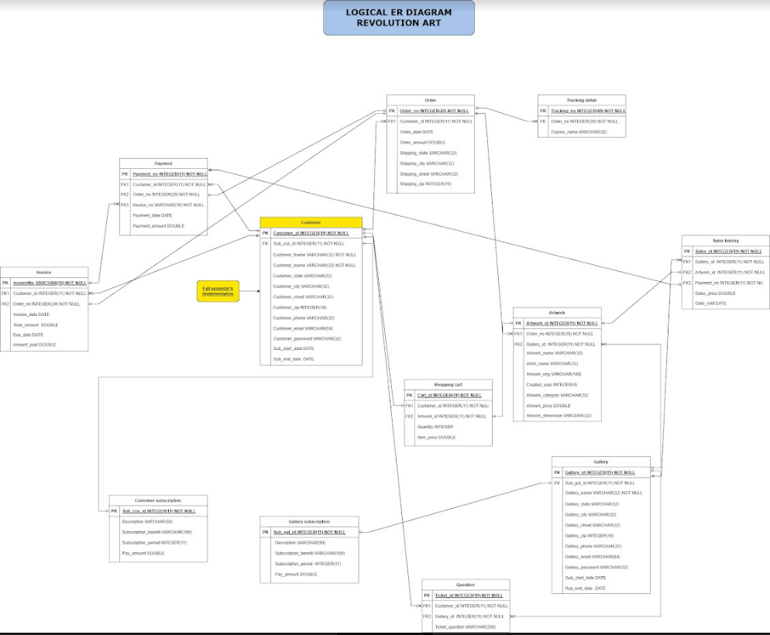
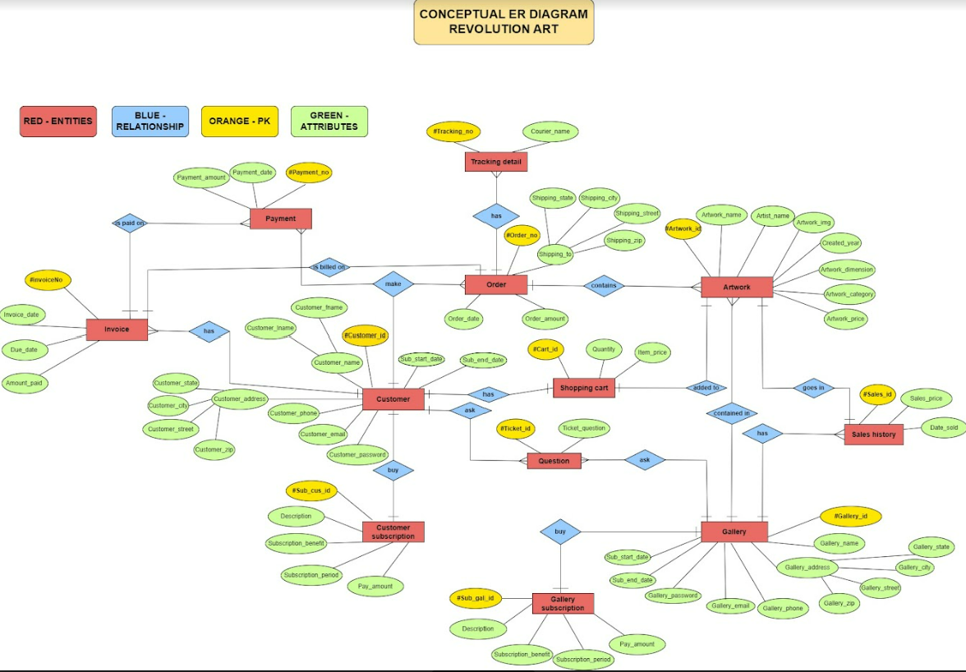
ER Diagram

Slide 11
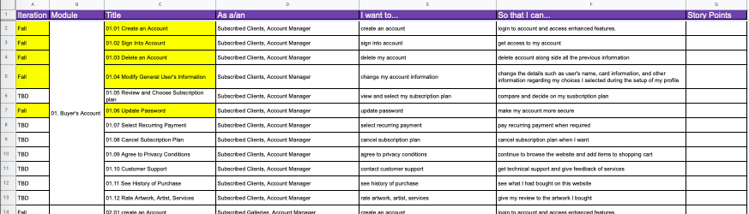
Functional Specs (User Stories)

Slide 12
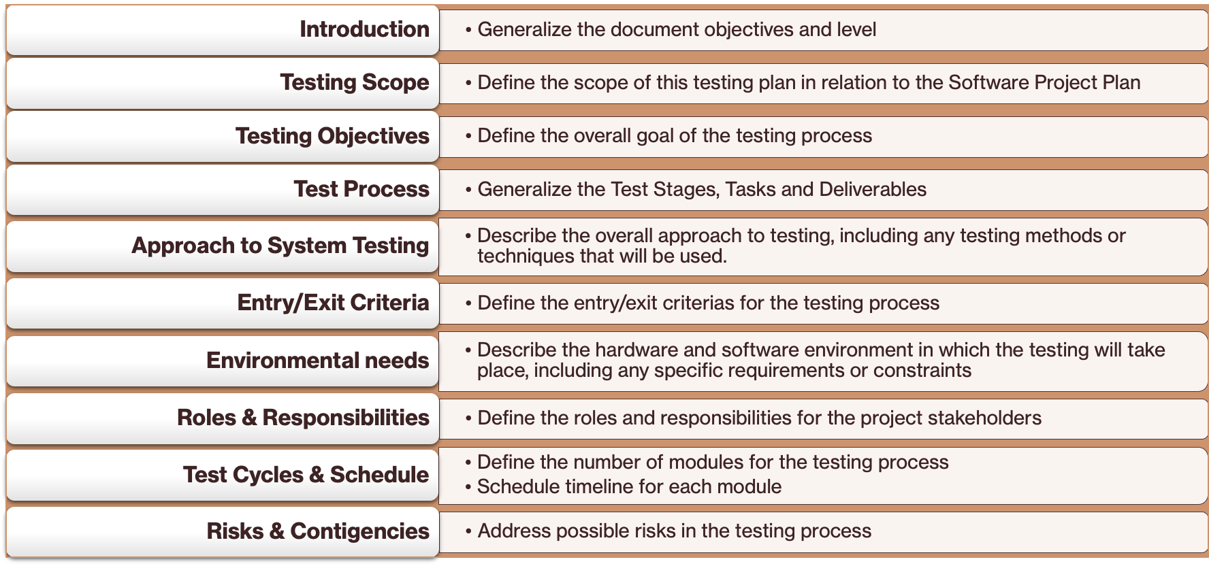
Test Plan

Slide 13
Github

Slide 14
Application Demo

